Slide 1
Writing Papers in the Biological Sciences
An introduction to Biological research and paper writing

Slide 2
Chapter Eight: Preparing the Final Draft
Mechanics and Technicalities
Use the scientific names of organisms.
  Genus species
  May be abbreviated G. species
  Always italicized
  Don’t use the, a, or an directly before a scientific name
  Do not pluralize scientific names.
  Taxonomic groups, or taxa, above the level of genus (family, order, class, phylum, division, and so on) are capitalized but not italicized or underlined. (e.g: Triticum aestivum L.)

Slide 3
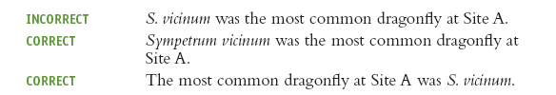

Give the full scientific name the first time a particular species is referred to in the text.
Biologists use conventional abbreviations to refer to one or more undesignated species of a particular genus:

Slide 4

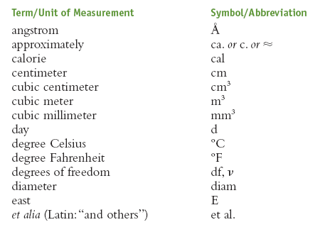
Record time according to a 24-hour system.
Use symbols and abbreviations commonly used in biology.
There is some variation from one scientific journal to the next.

Slide 5
Manuscript Format:
Paper, Margins, and Spacing
  Font: 12 point Arial or Times New Roman
  Margins: 1 inch on each side (standard)
  Left Alligned
Title Page
An acceptable format for a student paper calls for the following information on the title page: title of the paper, your name, course information, and the date.
Center the title and place it about one-third down the page; center and double-space all successive lines under the title.
Capitalize the first letter of all important words on the title page — that is, words other than articles (a, an, the), coordinating conjunctions (and, but, or, for, nor, so, yet), and prepositions (in, on, to, and the like).

Slide 6
Pagination
Number pages consecutively beginning with the title page (which does not actually carry a number, but is still counted).
Use only Arabic numerals (1, 2, 3, . . .), and put the number in the upper right-hand corner of each page.
Writers submitting a research paper for publication often begin each major section of the paper (Abstract, Introduction, Materials and Methods, and so on) on a separate page.

Slide 7
Headings
Headings are useful organizational tools. They can designate major portions of a work
Use headings and subheadings sparingly.
Overuse of headings results in a fragmented text, with many small sections.
Make headings informative and concise.
Use the same format for headings on the same level of organization.

Slide 8
Figures and Tables
Biological journals usually require authors to put each table or figure on a separate page.
The title of a table is typed on the same page as the table; however, figure legends are typed together on a separate page.
Tables, figures, and figure legends are then placed at the end of the Literature Cited section
in that order.
For electronic submission of figures, journals have additional technical specifications.

Slide 9
Acknowledgments section:
In published biological papers, a short Acknowledgments section usually comes between the Discussion and the Literature Cited sections.
Here you express thanks to people who assisted you with the research itself or with the preparation of the paper.
Scientific ethics dictate that you first obtain the permission of all those you intend to acknowledge, preferably by showing them a copy of that section of the paper.

Slide 10
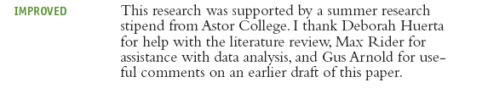
You may wish to include a Acknowledgments section at the end of some course assignments, such as thesis or senior independent research project.
Whether in published or unpublished works, the Acknowledgments should be formal, brief and concise.

Slide 11
Proofreading:
Typographical errors, misspelled words, missing commas or periods, irregular spacing, and other minor errors distract the reader and undermine your authority as a writer.
The aim of proofreading is to eliminate such mistakes from the final draft of the manuscript.
Proofread the whole manuscript more than once over a period of several hours or days; you may miss some errors the first time but notice them during the second or third proofreading.
Ask a friend to look over the paper as well.

